Slide 1
An Internet Latency Measurement Study
Ben Zhang
Ahir Reddy

Slide 2
Template
Notes:
Slide #2: Motivate your project by describing why its solution is important. Who would care if you are successful and why?

Slide 3
Problem
We seek to measure and characterize latency as it relates to:
Wide Area Networks
Data Centers*
Cellular Networks
* Not latency inside DC, rather a comparison to WAN
Notes:
Slide #1: Concisely describe the problem your project seeks to solve (e.g., demonstrate very fast access to remote memory, provide better network support for virtual machine migration, manage multiple wireless network interfaces more effectively, etc.).

Slide 4
Motivation
Understanding state-of-art Internet latency
In comparison to speed-of-light limit
Geographical correlation (Latency vs. Distance)
Time-series patterns
Latency experienced by end user in the following model
User ----> WAN ----> DC ----> WAN ----> User
Discover the fraction of latency on WAN and inside DC
Unclear cellular latency dynamics
Mobile users experience long latency due to the setup time or long paths (travel to undesired place first)
How the signal strength, load balancing affect latency experienced by users is unknown
Notes:
Slide #2: Motivate your project by describing why its solution is important. Who would care if you are successful and why?

Slide 5
Prior Work
End-to-end latency measurement (no recent studies)
King, T-King methods for arbitrary two hosts (DNS recursive query)
Vern’s work on end-to-end dynamics (~1995)
Datacenter Application Deadline (no comparison to WAN latencies)
[Sigcomm’ 11 Better Never than Late]
[Sigcomm’ 12 DeTail]
Cellular Network (no dynamics analysis)
[Sigmetrics’ 11 Xu] Cellular network infrastructure study
[MobiPerf] A lightweight mobile application for measurement
Notes:
Slide #3: Describe prior work. If your problem is so important, why hasn't it been solved already? What has already been done and where does it fall short?

Slide 6
Approach
WAN
Measurement methodologies are based on the King/T-King methods (recursive DNS query)
Do a continuous study on a daily/weekly basis
Use various techniques to infer DNS server locations and perform correlation
Filter out DNS forwarders that would otherwise skew results
Use Geo-IP to build latency vs. distance graph
DC
Use ping to get RTT
Perform Query to determine DC time (Query Time – Ping RTT)
Random Queries
Hot Trends
Google’s provided estimated query time
Mobile
Trick: use USB tethering so that various tools on PC can be used easily for measurement
Use traceroute to reverse engineer network topology
Notes:
Slide #4: Briefly discuss your technical approach. What are you (hopefully) new ideas for solving your problem? What will be your evaluation approach (e.g., what is the figure of merit for your project and how will you go about measuring it?).
----- Meeting Notes (4/3/13 13:22) -----
WAN
Use Turbo king to test a wide range of networks
Mobile
We are limited by the fact there there is not a distributed network of wireless nodes that we can use for testing. So instead we are looking to better understand the latency of the networks we have access

Slide 7
Turbo King - Setup
Crawl of reverse DNS Tree
236,000 DNS servers discovered
26,000 Open Recursive Resolvers
Turbo King Infrastructure
56 Measurement Nodes (Planet Lab)
2 Central Name Servers (EC2)
Measurement nodes controlled via RPCs
Issue command measurement command (NS1, IP1, NS2, IP2)
Receive Latency Results and presence of DNS Forwarder
Notes:
Slide #2: Motivate your project by describing why its solution is important. Who would care if you are successful and why?

Slide 8

Turbo King – Open Resolvers
Notes:
Slide #2: Motivate your project by describing why its solution is important. Who would care if you are successful and why?

Slide 9
Turbo King (Modified)
myAddr
1) Resolve: qid.myAddr.mydomain.com
ns.target1.com
(Recursive)
ns.target2.com
(Recursive or Iterative)
DNS Client
6) Resolve: qid.myAddr.mydomain.com
8) NXDomain
5) Referral: ns.target2.com
DNS Server
7) NXDomain
4) Resolve: qid.myAddr.mydomain.com
2) Resolve: qid.myAddr.mydomain.com
ns1.mydomain.com
3) Referral: myAddr
Record time delta T between (5) and (8)
Determine RTT between myAddr and target1
Latency target1 to target2 = T - RTT
Notes:
Slide #2: Motivate your project by describing why its solution is important. Who would care if you are successful and why?

Slide 10
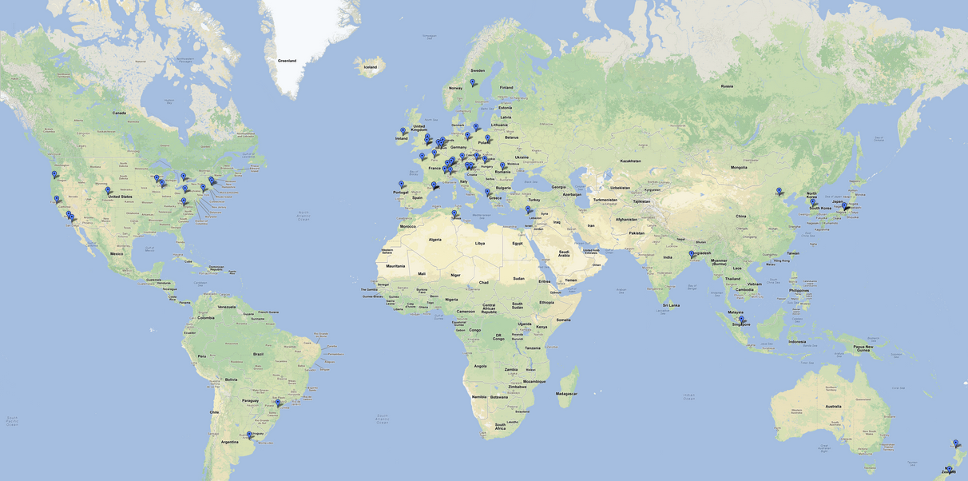
Turbo King – Planet Lab Nodes
Notes:
Slide #2: Motivate your project by describing why its solution is important. Who would care if you are successful and why?

Slide 11
Turbo King – Measurement Statistics
Time?
Data Points?
Notes:
Slide #2: Motivate your project by describing why its solution is important. Who would care if you are successful and why?

Slide 12
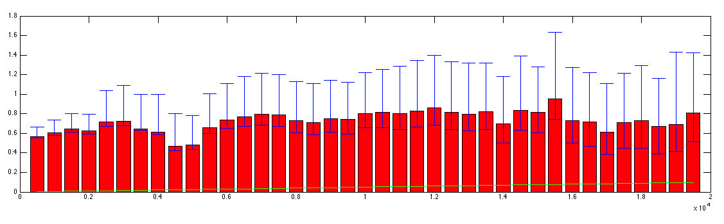
Turbo King – Latency vs. Distance
Fit lines, and a*x+b, r stats
Notes:
Slide #2: Motivate your project by describing why its solution is important. Who would care if you are successful and why?

Slide 13
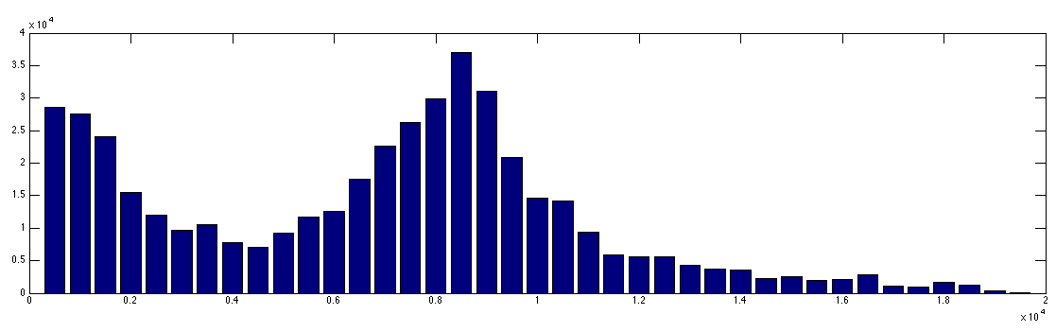
Turbo King – Distribution of Distances
Notes:
Slide #2: Motivate your project by describing why its solution is important. Who would care if you are successful and why?

Slide 14
Turbo King – Analysis
Distribution of Distances
Intercontinental patterns
Filter
Measurements faster than speed of light
Incorrect Geo IP
Extremely High Latencies (5 second timeout)
Results returned by forwarders
DNS Forwarders
Large Impact on Results
Nearly 25% of all queries returned by forwarders
Notes:
Slide #2: Motivate your project by describing why its solution is important. Who would care if you are successful and why?

Slide 15
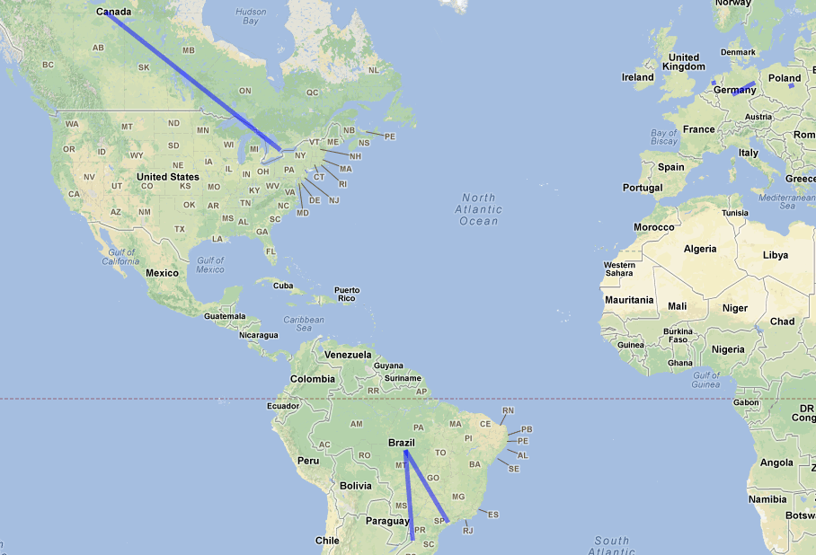
Turbo King – DNS Forwarders
Notes:
Slide #2: Motivate your project by describing why its solution is important. Who would care if you are successful and why?

Slide 16
Data Center (Ben)
Insert graph for random query
Hot trends
And ping
Also statistics of measurement
Notes:
RFC 1918
172.16.0.0 - 172.31.255.255 (172.16/12 prefix)

Slide 17
Mobile (Ben)
[AS0] 172.20.10.1
~0.7 ms
[AS16509] 172.26.236.2
~35 ms
[AS16509] 172.26.241.133
~35 ms
Add graph
Delay-hop
Routers-hop
Flaps-hop
[AS0] 172.26.96.10/172.26.96.11
172.26.96.3/172.26.96.2
~35 ms
[AS0] 172.26.96.193
~35 ms
[AS0] 172.16.121.113
~50 ms
[AS7018] 12.249.2.49
~60 ms
[AS7018] 12.83.180.82
~50 ms
[AS7018]
12.122.200.9/12.122.114.5
12.122.1.118/12.122.8.79…
40 ms -
100 ms
[AS7018]
12.122.114.21/12.123.30.5
[AS0]
192.205.33.46/…
40 ms -
100 ms
Possibly Internet…. 50 ms – 200 ms
Notes:
RFC 1918
172.16.0.0 - 172.31.255.255 (172.16/12 prefix)

Slide 18
Questions & Feedback?
Thank you!

